Slide 1





Chinook Music Store Analysis
By – SAIRAJ JADHAV

Slide 2


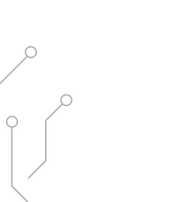
AGENDA
Total Tasks performed in the presentation are as follows:
Data Schema
Managing Missing & Null Values
Analysis Of Objective & Subjective Questions
Data Modification in SQL
Recommendations
Conclusion

Slide 3
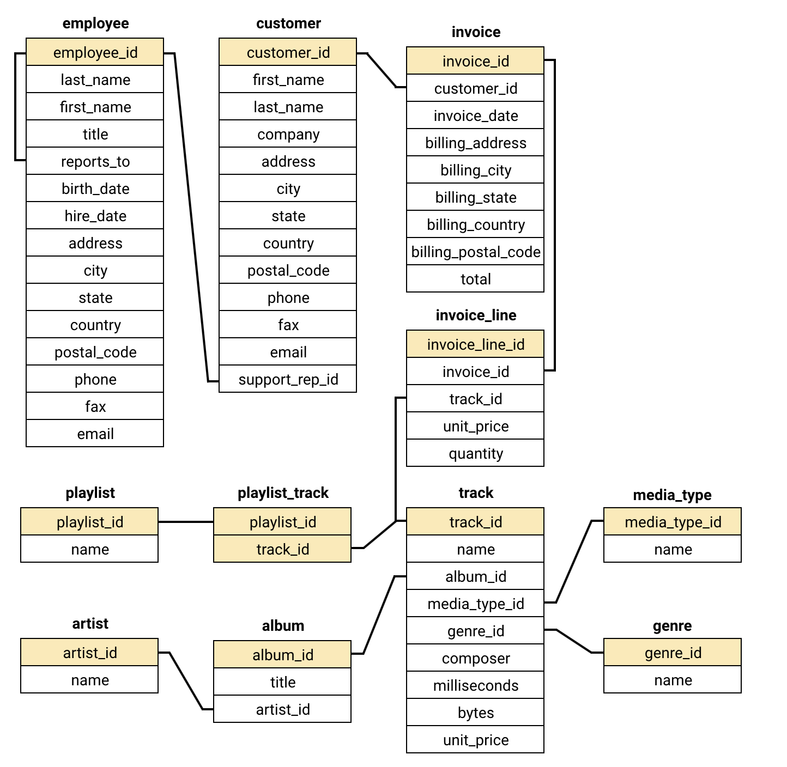


DATA SCHEMA-

Slide 4







MANAGING MISSING VALUES & DUPLICATES
Effective methods for managing data inconsistencies
IDENTIFYING MISSING VALUES & DUPLICATES
COALESCE() FUNCTION
UPDATE STATEMENT
Assess tables for NULLs and duplicate entries.
Replace NULLs with default values using COALESCE().
Modify values based on conditions with UPDATE.
NULLS IN CUSTOMER TABLE
NULLS IN TRACK TABLE
NUMERIC REPLACEMENT STRATEGY
NULL values found in company, state, phone, fax.
NULL values observed in the composer column.
Use 0 for NULL in numeric fields.
TEXT REPLACEMENT STRATEGY
EXAMPLE REPLACEMENT
Use placeholders like 'None' for text fields.
Replace NULL composer with 'Unknown'.

Slide 5








HANDLING NULL VALUES IN TABLES
Strategies for Replacing NULL Values Effectively
TABLES WITH NULL VALUES
COLUMN NAME/ATTRIBUTE
VALUE TO BE REPLACED
Customer
Company
'Unknown'
Customer
State
'None'
Customer
Phone
'+00000000000'
Customer
Fax
'+00000000000'
Track
Composer
'Unknown'

Slide 6
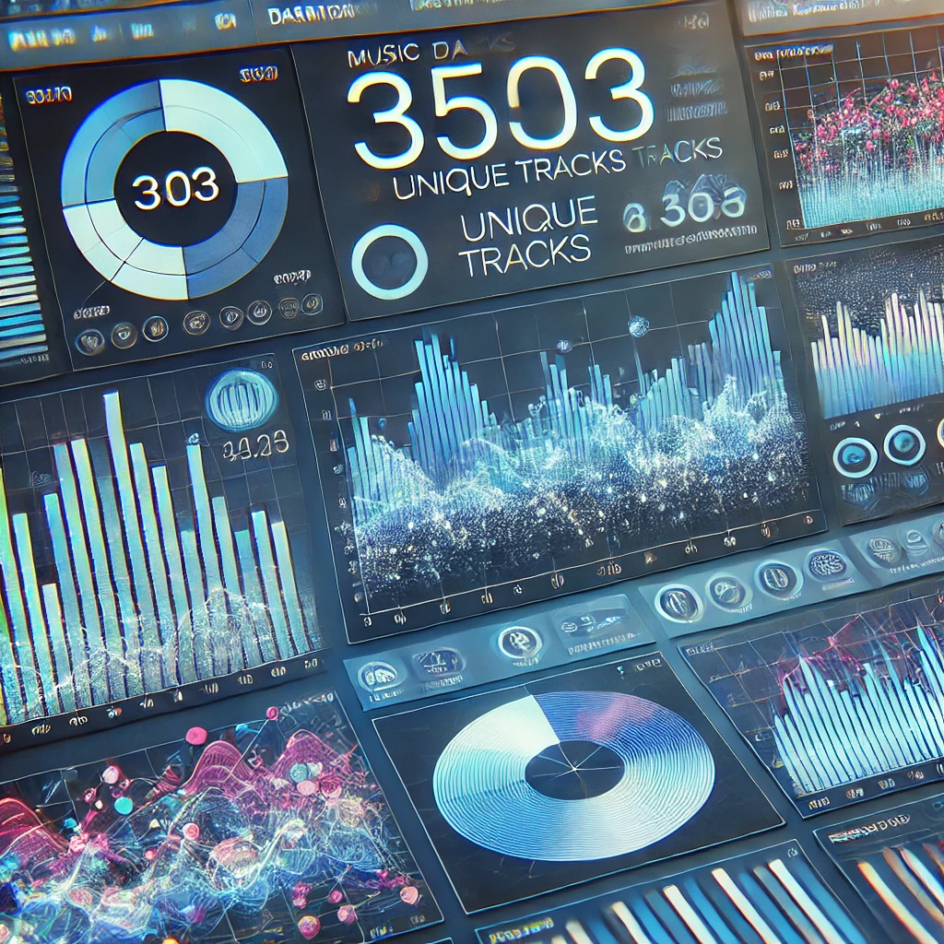
TOP-SELLING TRACKS ANALYSIS
Analyzing top tracks and artists in the USA
3503 unique tracks analyzed
Leading artist
IDENTIFIED TOP ARTIST
The analysis revealed the top artist in sales.
EXTENSIVE DATASET REVIEWED
Analyzed top-selling tracks in the USA.
Sum of total sales
Multiple genres identified
HIGH REVENUE FROM TRACKS
DIVERSE MUSIC LANDSCAPE
Total sales reflect the profitability of tracks.
The analysis showcased various popular genres.

Slide 7
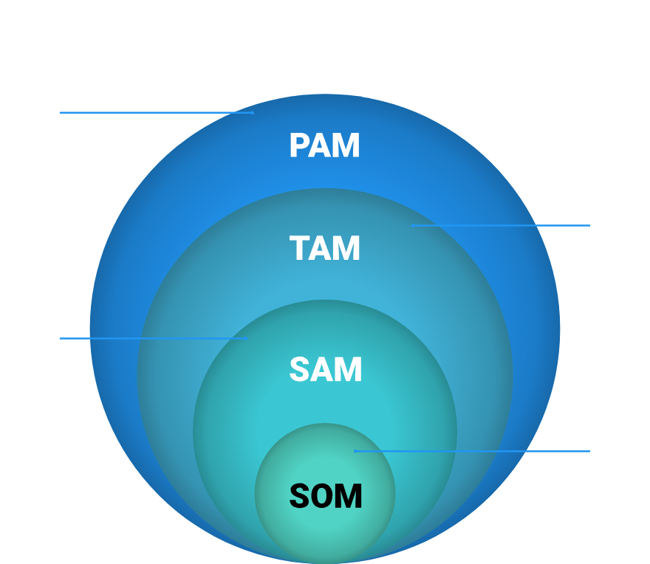
CUSTOMER DEMOGRAPHICS ANALYSIS
Analysis of Customer Demographics by Country, State, and City
TOTAL LOCATIONS ANALYZED
Analyzed data from 59 unique country locations.
COUNT(customer_id)
CUSTOMER COUNT
Customer distribution across countries and states.
COALESCE(state, 'None')
STATE REPRESENTATION
State data represented, with 'None' for missing.
GROUP BY country, state, city
DATA AGGREGATION
Data aggregated for clarity in demographics.

Slide 8





TOTAL REVENUE AND INVOICES CALCULATION
Analyzing revenue and invoice distribution by region
Number of Invoices: 614
Total Revenue: $4709
Countries Involved: 59
Average Invoice Value: $7.67
Top City: Prague
HIGH INVOICE COUNT SHOWS ACTIVE TRANSACTIONS.
REVENUE REFLECTS STRONG SALES PERFORMANCE.
DIVERSE MARKET PRESENCE ENHANCES STABILITY.
HEALTHY AVERAGE INDICATES QUALITY SALES.
Prague GENERATES THE HIGHEST REVENUE.
Indicates a strong customer base in urban areas.
Indicates high customer demand and successful strategies.
Reduces risk by spreading sales across different regions.
Suggests effective pricing strategies and customer spending.
Demonstrates robust business activity across regions.

Slide 9
TOP GENRES BY PURCHASE QUANTITY
Analysis of top 3 Genres by Purchase Quantity
Rock is the most popular genre –
It is the highest purchased genre for all three customers:
Frank: 64
František: 67
Helena: 76
Alternative & Punk is the second most popular genre –
It appears consistently in the top 3 for all customers:
Frank: 20
František: 16
Helena: 24
Metal is another strong preference –
It ranks in the top 3 for Frank (32), František (14), and Helena (9), indicating a solid demand across all three.
COUNTRY
TOTAL REVENUE

Slide 10
TOP CUSTOMERS BY REVENUE ANALYSIS
Analysis of top 5 Countries by Total Revenue
USA Dominates Revenue – The USA has the highest total revenue, significantly surpassing the other four countries.
Canada in Second Place – Canada has the second-highest revenue, but it's much lower than the USA.
Balanced Revenue Among Other Countries – Brazil, France, and Germany have relatively similar revenue figures, with Brazil slightly ahead of France and Germany.
Germany Has the Lowest Revenue – Among the top five countries, Germany has the lowest total revenue.
COUNTRY
CUSTOMER
TOTAL REVENUE

Slide 11




CUSTOMER TRACK SALES ANALYSIS
Identifying Top-Selling Tracks for Each Customer
59 Rows Returned
1 Track per Customer
ROW_NUMBER() function
SUM(i.total)
TOTAL SALES RECORDS IDENTIFIED
TOP-SELLING TRACK IDENTIFIED
SALES RANKING IMPLEMENTED
AGGREGATED TOTAL SALES
Total sales calculated for each track.
Demonstrates comprehensive customer sales tracking.
Each customer has a unique best-selling track.
Ranks tracks by sales for each customer.

Slide 12


CUSTOMER PURCHASING BEHAVIOR INSIGHTS
HIGH CUSTOMER ENGAGEMENT
59 total purchases
Indicates strong purchasing frequency.
PURCHASE FREQUENCY INSIGHT
Analyzing Trends in Customer Purchases
Average 30 days between purchases
Shows the average duration for repeat purchases.
HEALTHY REVENUE PER TRANSACTION
$7.8 average order value
Represents a lucrative customer spending behavior.
LONG-TERM CUSTOMER BASE
Minimum purchase date: 2020-01-01
Highlights established customer relationships.
RECENT ACTIVITY TREND
Maximum purchase date: 2023-09-30
Shows ongoing engagement and sales.

Slide 13
CUSTOMER CHURN RATE INSIGHTS
Understanding Customer Churn Metrics and Implications
X churned customers
Y total customers
Z% churn rate
180 days
CHURNED CUSTOMERS COUNT
TOTAL CUSTOMER BASE
CHURN RATE PERCENTAGE
CHURN THRESHOLD SET
Customers inactive for over 180 days are classified as churned.
Indicates the percentage of customers lost during the period.
Identifies the total number of customers lost.
Reflects the customer base at the start of the period.

Slide 14
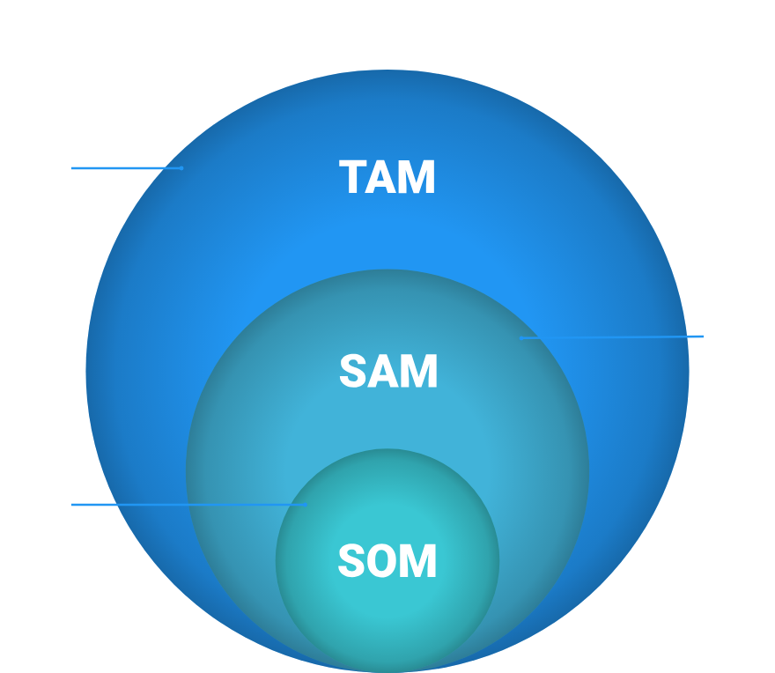
CUSTOMERS BY GENRE PURCHASES
Identifying Customers Across Multiple Genres
59 Rows Returned
ACTIVE CUSTOMERS BY GENRE
Total customers purchasing across genres.
3 Different Genres
MINIMUM GENRE PURCHASES
Customers must buy from at least 3 genres.
COUNT(DISTINCT g.genre_id)
UNIQUE GENRES COUNT
Counts unique genres per customer.

Slide 15
SALES PERFORMANCE RANKING OF GENRES
Ranked Sales Data for Music Genres in the USA
Top Genre: Rock dominates sales with 554.4 in total revenue.
Strong Contenders: Alternative & Punk (128.7) and Metal (122.76) follow in second and third place.
Moderate Performers: R&B/Soul, Blues, and Alternative genres show mid-tier sales between 34-52.
Lowest Ranked: TV Shows genre ranks last with 0.99 in total sales.
Tied Sales: Pop and Latin genres have the same total sales (21.78),sharing rank 7.
GENRE
TOTAL SALES
GENRE RANK

Slide 16
INACTIVE CUSTOMERS IDENTIFICATION
A comprehensive approach to identify inactive clients
CHALLENGE OF INACTIVE CUSTOMERS
CONCEPTS UTILIZED
SQL QUERY OVERVIEW
JOIN OPERATIONS
CTE, Joins, and Aggregate Functions are key.
Use CTE to track last purchase dates.
Joining customer and invoice tables for data.
Identifying customers without purchases in 3 months.
AGGREGATE FUNCTIONS
FILTERING INACTIVE CUSTOMERS
QUERY RESULT
MAX function captures latest purchase date.
Identified 35 inactive customers successfully.
SQL checks for no purchases in the last 3 months.

Slide 17

TOP ALBUM PROMOTION STRATEGIES
Prioritized Albums for USA Advertising
01
1. SEEK AND SHALL FIND: MORE OF THE BEST
08
SALES VALUE: 370.26
R&B/Soul album with highest sales value.
Classic appeal contributes to strong sales opportunities.
02
SALES VALUE: 387.09
09
PROMOTION JUSTIFICATION: ROCK DOMINANCE
Demonstrates strong demand for R&B/Soul.
Rock genre shows leading sales representation.
03
REASON FOR PROMOTION: HIGH DEMAND
10
R&B/SOUL AUDIENCE DEMAND
Leads in sales, indicating strong audience interest.
High sales indicate strong listener base for R&B.
04
2. FROM THE MUDDY BANKS OF THE WISHKAH LIVE
11
STRATEGIC INVESTMENT OPPORTUNITY
Live rock album with significant sales value.
Promoting these albums can drive significant engagement.
05
SALES VALUE: 379.17
Reflects popularity and engagement in the rock genre.
06
REASON FOR PROMOTION: DEDICATED FAN BASE
Live albums attract loyal followers, boosting sales.
07
3. ARE YOU EXPERIENCED?
Classic rock album with high sales potential.

Slide 18




TOP-SELLING GENRES OUTSIDE THE USA
Analysis of global music genre sales trends
Rock Leads the Market – Rock music has the highest sales, reaching 2053.6, significantly outperforming other genres.
Metal in Second Place – Metal follows with 490.05 in total sales, showing strong popularity.
Alternative & Punk Holds Third – With 358.38 in sales, it remains a competitive genre.
Latin Music in Fourth – Latin music has 143.55 in total sales, maintaining a notable presence in the market.
2053.6
490.05
358.38
143.55
Rock
Metal
Alternative & Punk
Latin
GENRE

Slide 19








SALES ANALYSIS OF MUSIC GENRES
Comparative Analysis of Genre Sales Data
GENRE
SALES (OUTSIDE USA)
SALES RANK (USA)
Rock
2053.6
1
Metal
490.05
3
Alternative & Punk
358.38
6
Latin
143.55
Not in USA Chart
R&B/Soul
Not in Non-USA Chart
36
Blues
Not in Non-USA Chart
27

Slide 20



SALES COMPARISON: USA VS. OTHER COUNTRIES
Analyzing Music Sales Trends Across Borders
COMMONALITIES
DIFFERENCES
1.
Rock is the leading genre in both USA and international markets with 412 sales.
1.
Latin music ranks as a top-selling genre outside the USA but does not feature in the USA's top sales.
2.
Metal and Alternative & Punk genres show significant sales numbers in both markets.
2.
R&B/Soul and Blues are popular in the USA, appearing in the top-selling genres, yet are absent from international rankings.

Slide 21




583 purchases
31 purchases
CUSTOMER PURCHASING BEHAVIOR ANALYSIS
LONG-TERM CUSTOMERS BUY MORE FREQUENTLY
NEW CUSTOMERS BUY LESS OFTEN
New customers exhibit lower purchase frequency.
Long-term customers show a high purchase frequency.
Comparative Insights on Long-Term vs. New Customers
9.8
9.3
HIGHER AVERAGE SPENDING OF LOYAL CUSTOMERS
NEW CUSTOMERS SPEND SLIGHTLY LESS
Long-term customers spend more on average.
New customers show lower average spending.

Slide 22
PRODUCT AFFINITY ANALYSIS INSIGHTS
Exploring purchase patterns in music genres and albums
GENRE-BASED AFFINITY
COMPLEMENTARY GENRES
CROSS-SELLING STRATEGIES
RECOMMENDATION SYSTEMS
Rock and Metal albums are frequently purchased together.
Latin and Blues as secondary choices for bundling.
Combine Rock & Metal into discount bundles.
Suggest albums based on customer purchase patterns.
PERSONALIZED PLAYLISTS
ARTIST/ALBUM ANALYSIS
EXAMPLE OF ARTIST AFFINITY
Curate playlists that enhance engagement for users.
Examine data for artist-specific purchasing trends.
If Led Zeppelin is bought, recommend Metallica.

Slide 23






REGIONAL MARKET ANALYSIS INSIGHTS
Understanding Variations in Customer Behavior
COUNTRY
TOTAL CUSTOMERS
CHURN RATE
Argentina
1
100
Belgium
1
100
Chile
1
100
Hungary
1
100
Italy
1
100
Netherlands
1
100
Norway
1
100

Slide 24


REGIONAL MARKET ANALYSIS INSIGHTS
Understanding Variations in Customer Behavior
COUNTRY
TOTAL CUSTOMERS
CHURN RATE
Germany
2
50
France
2
50
Czech Republic
2
50
USA
13
15.38
Brazil
8
37.5

Slide 25
CUSTOMER RISK PROFILING INSIGHTS
HIGH-RISK REGIONS IDENTIFIED
Countries like Italy and Norway show 100% churn.
Analyzing factors influencing customer retention and churn
MODERATE-RISK AREAS
USA and Canada exhibit churn rates of 15.38% and 37.5%.
LOW-RISK REGIONS DETECTED
Countries with 0% churn include Finland and Australia.
DEMOGRAPHICS IMPACT CHURN
Younger customers show less loyalty, increasing churn.
ECONOMIC FACTORS MATTER
Economic instability correlates with higher churn rates.
PURCHASE BEHAVIOR TRENDS
Infrequent purchases signal potential churn risk.
ENGAGEMENT ISSUES
Poor customer service drives higher churn rates.

Slide 26
CUSTOMER LIFETIME VALUE INSIGHTS
Utilizing Customer Behavior for Marketing Strategies
Targeted win-back campaigns
1,990 days
High frequency purchases
Low engagement frequency
VIP discounts offered
CHURN RISK IDENTIFIED
RECOVER LOST CUSTOMERS
HIGH-VALUE CUSTOMERS
TARGET RE-ENGAGEMENT
BOOST RETENTION
Daan Peeters shows disengagement.
Niklas and Hannah are top customers.
Low-frequency customers need attention.
Incentives for loyal customers can help.
Email campaigns to re-engage churned users.

Slide 27
CUSTOMER SPENDING ANALYSIS INSIGHTS
HIGHER ENGAGEMENT IN PURCHASING TRACKS
Average Tracks per Customer: 15.5
Indicates customers are actively buying music.
Analyzing Customer Behavior by Country
SIGNIFICANT REVENUE GENERATION
Total Spent: 4709$
Reflects strong market demand for music.
LARGE CUSTOMER BASE
Number of Customers: 59
A robust audience for marketing strategies.
HEALTHY AVERAGE SPENDING
Average Total Spent: 7.6$
Shows potential for upselling opportunities.

Slide 28







SQL TABLE MODIFICATION TECHNIQUES
Steps to Add a New Column in SQL Database
OBJECTIVE OF SQL MODIFICATION
UTILIZING ALTER COMMAND
UNDERSTANDING SYNTAX
Aim to enhance the 'Albums' table by adding a new column.
The ALTER statement is essential for modifying tables.
Syntax: ALTER TABLE table_name ADD COLUMN column_name datatype;
EXECUTING THE QUERY
TESTING THE MODIFICATION
VISUAL OUTPUT
Use the specific query to add 'NewReleaseYear' column.
Verify changes using SELECT * FROM album command.
Check the output to confirm successful modification.

Slide 29






RECOMMENDATIONS-
Evaluate the effectiveness of promotional strategies
CUSTOMER ACQUISITION
01
Measure new customers gained and their purchases.
02
RETENTION ANALYSIS
Assess repeat purchases and churn rates.
SALES PERFORMANCE
03
Compare revenue and order values during campaigns.
04
CUSTOMER SEGMENTATION
Identify responsive customer groups for targeting.
ENGAGEMENT INSIGHTS
Evaluate email interactions and redemption rates.
05

Slide 30

CONCLUSION
This analysis provides valuable insights into customer purchasing behavior and preferences based on geographic location and genre popularity, enabling targeted recommendations.
Identifying high-revenue customers and tracking purchase frequency helps businesses re-engage inactive customers and prevent churn in high-risk segments.
The data highlights the dominance of specific genres, such as Rock, across various locations, offering cross-selling and upselling opportunities based on regional and customer preferences.
Differences in purchasing patterns between long-term and new customers reveal opportunities for loyalty programs and personalized offers, ultimately enhancing customer retention and satisfaction.

